Slide 1
Rotary Peace Fellowships
A Program Overview and Update
Notes:
Suggested audience: Rotary District Conferences, Multidistrict PETS, and Zone Institutes
Presentation provides an overview of the Rotary Peace Centers Program

Slide 2
Rotary Peace Centers Program Vision:
The Rotary Peace Centers program has a vision of sustainable peace: encompassing a network of peacebuilders and community leaders dedicated to preventing and resolving conflicts across the global community.
Notes:
The Rotary Foundation of Rotary International established the Rotary Peace Centers Fellowship to honor Paul Harris, the founder of Rotary International, on the 50th anniversary of his death.

Slide 3
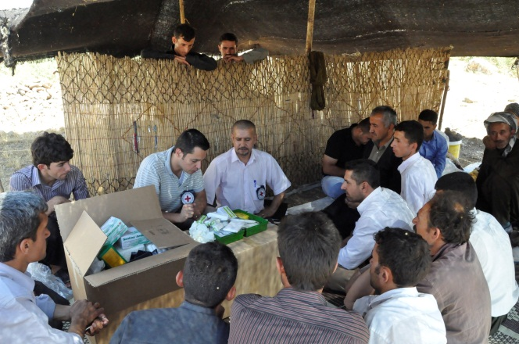
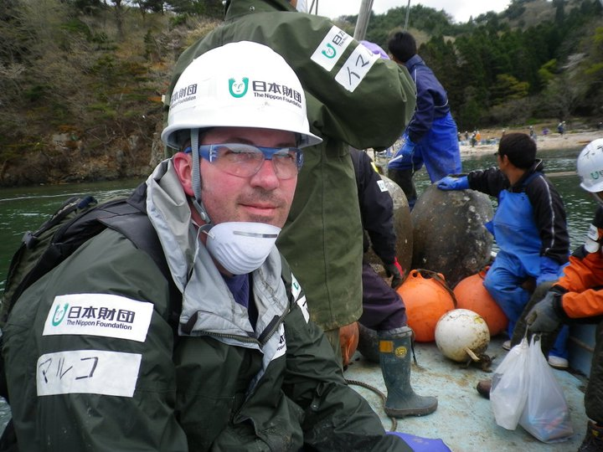
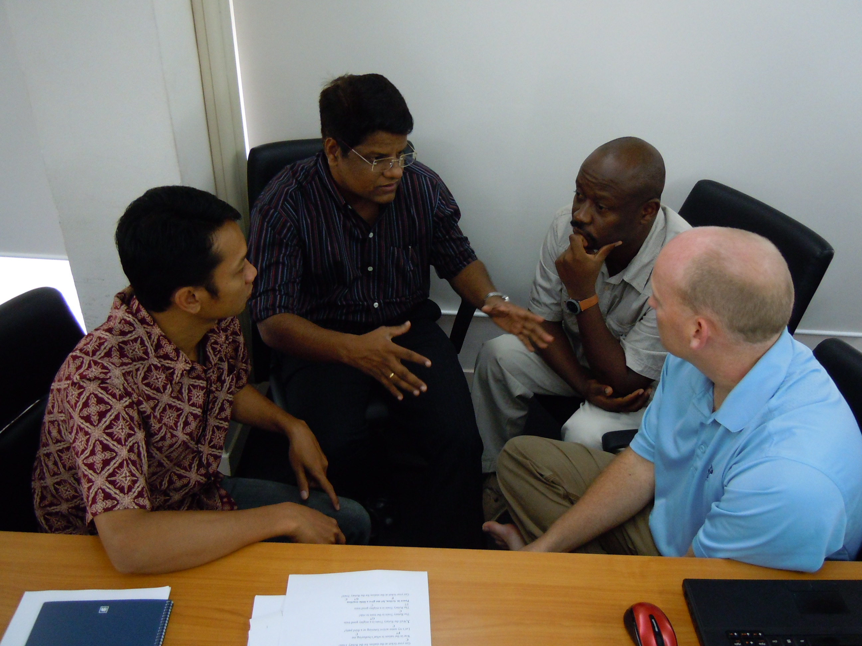
Rotary Peace Centers Mission
EMPOWER
BE A CATALYST
GLOBAL IMPACT
ACADEMIC TRAINING
BUILD CAPACITY
Notes:
The Rotary Foundation of Rotary International established the Rotary Peace Centers Fellowship to honor Paul Harris, the founder of Rotary International, on the 50th anniversary of his death.
The mission of the program is:
In order to serve this vision, Rotary has created a unique partnership with top universities around the world.
The Rotary Peace Centers program empowers, educates, and increases the capacity of peace builders through rigorous academic training, practice, and global networking opportunities.
Through this experience, Rotary Peace Fellows build the skills needed to act as leaders and catalysts for peace and conflict resolution both in their communities and around the globe.

Slide 4
Rotary Peace Centers
Head
Bullets
Notes:
There are currently six Rotary Peace Centers at seven universities around the world.
Joint program at Duke University and the University of North Carolina-Chapel Hill
University of Bradford in England
Uppsala University in Sweden (our newest center)
International Christian University in Japan
University of Queensland in Australia
Chulalongkorn University in Thailand, which hosts our professional development certificate program

Slide 5
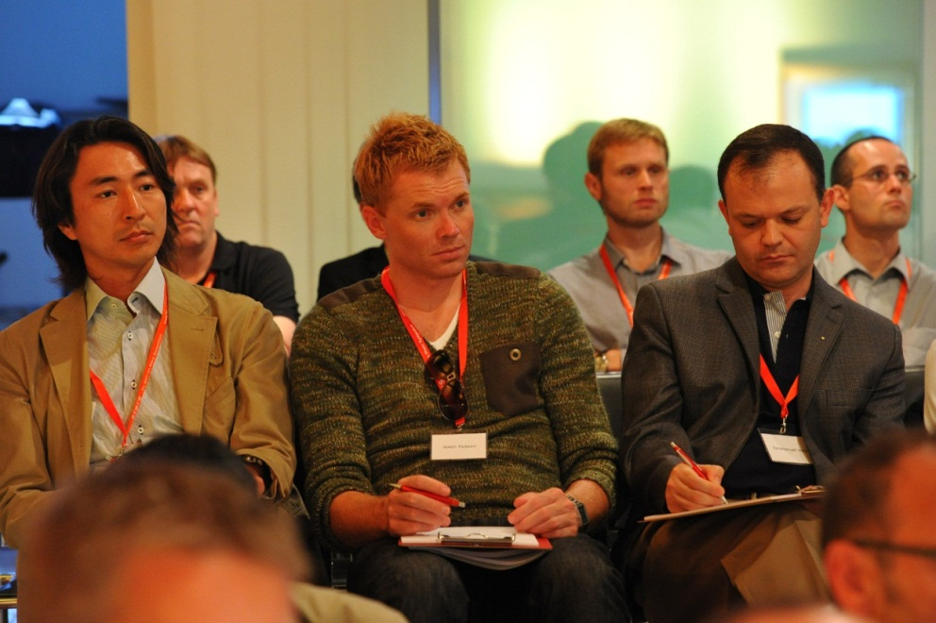
Two Options for Study
Master’s Degree
“Building the leaders of tomorrow”
Professional Development Certificate
“Strengthening the leaders of today”
Notes:
The program has two options for study: the master’s degree program and the professional development certificate program. Both are fully funded fellowships that offer opportunities for people at different stages in their career.
The master’s degree is targeted toward professionals that are early in their career in peace and conflict resolution while the professional development certificate is targeted more toward mid- to upper-level professionals already working in the field of peace and conflict resolution.

Slide 6
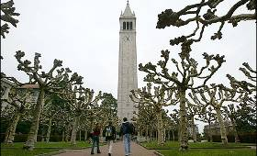
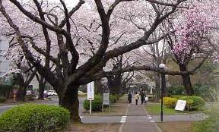
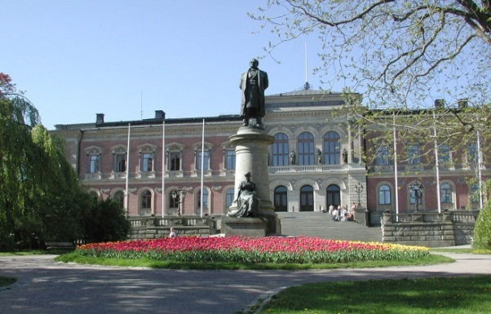
Master’s Degree
Five centers at six universities
Fifteen to 24 month course
Ten new fellows at each center every year
Notes:
The master’s degree program is a multi-institution partnership between The Rotary Foundation and leading universities around the world. The programs range in length from 15-24 months and each university has their own specialization and policies. Depending on the center, fellows can earn degrees in peace and conflict resolution, international law and development policy, public health, urban planning, and other related degrees. Applicants must have a bachelor’s degree or its equivalent and have at least three years of relevant work experience (either paid or volunteer). Each year 10 new fellows are selected for each center. For more information please visit www.rotary.org/rotarycenters.

Slide 7
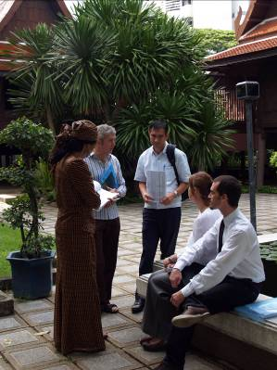
Structure of the Master’s Program
Core courses in peace and conflict resolution
Specialized courses and research
Applied field experience (AFE)
Annual peace seminar
Notes:
The Rotary Peace Centers program was created with four primary components in mind at each center:
1. Core courses about Peace and Conflict Resolution
2. Courses and research to support a fellow’s area of interest or specialization
3. Applied field experience (Internship). Past fellows have done their AFEs at the UN, Red Cross, Human Rights Watch, The Hague, International Palestinian Youth League, Save the Children, and many more.
4. Annual peace seminar at each university which provides an opportunity for fellows to share research. These seminars are open all Rotarians.

Slide 8
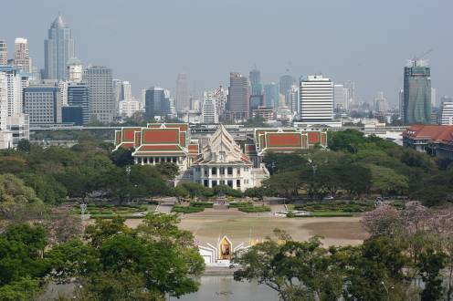
Professional Development Certificate
One center
Three month course
Two sessions per year
Up to 25 fellows in each session
Notes:
The second option for study is the professional development certificate at Chulalongkorn University in Bangkok, Thailand. The certificate lasts 3 months and includes up to 3 weeks of field study. The short format allows fellows to gain skills and knowledge they need and then return to their jobs upon completion. Certificate fellows must have a bachelor’s degree or the equivalent and have at least 5 years of relevant work experience. There are two sessions per year with up to 25 fellows in each session.

Slide 9
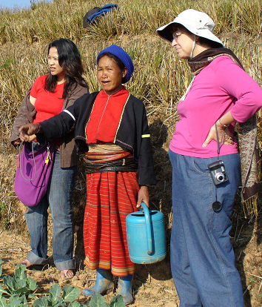
Structure of the Certificate Program
Eight weeks of foundational instruction in the classroom
On-site fieldwork in for 2 to 3 weeks
Notes:
Through its unique and diverse interdisciplinary program, the Rotary Peace Center at Chulalongkorn University provides academic and practical training to prepare fellows for leadership roles in solving the many problems that contribute to conflict around the world. In-class coursework provides theoretical foundational knowledge. On-site fieldwork provides practical experience in applying theoretical knowledge to real-life situations.

Slide 10
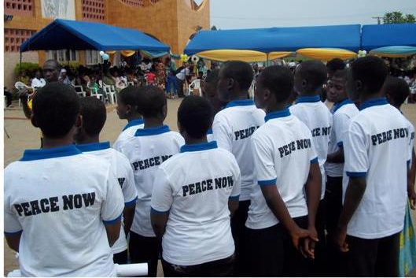
News & Updates
Peace related breakout session in Sydney in 2014
2015 Rotary World Peace Symposium in Sao Paulo, Brazil
New Mission and Vision for the Rotary Peace Centers program
Rotary Peace Fellows Leadership Retreat, April 2014
Notes:
2015 Rotary World Peace Symposium in Sao Paulo, Brazil
Planning will commence this year for the fourth Rotary World Peace Symposium to take place in Sao Paulo, Brazil. The Rotary World Peace Symposium is a triennial event that provides an opportunity for peace fellows, Rotarians and experts in the field of peace and conflict resolution to come together to discuss the most pressing issues in the field and well as providing a networking opportunity for fellows and Rotarians interested in issues of peace and conflict resolution. Over 600 Rotarians, Peace Fellow alumni and other TRF program alumni attended the 2012 Rotary World Peace Symposium in Bangkok, Thailand, keynoted by 2011 Nobel Peace Prize Laureate Madam Leymah Gbowee.
Visioning for the Rotary Peace Centers program
As 2012 marked the 10th anniversary of the program’s operations, The Rotary Peace Centers Committee conducted a visioning exercise to identify potential areas where the program has the opportunity to grow and to improve during its second decade of operation.
Rotary Peace Fellows Leadership Retreat – will take place in April 2014 with the theme: “Supporting sustainable peace-makers in the field: how to avoid burnout, promote adjustment and resilience in alumni.”

Slide 11
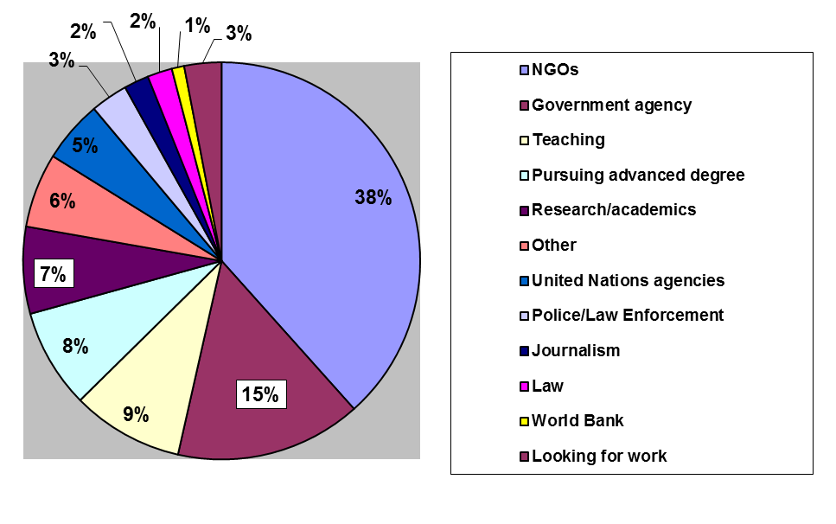
Alumni
Notes:
The Rotary Peace Centers program has over 700 alumni. 95% of these alumni work in areas related to peace and conflict resolution. The graph shows the percentages of where peace fellows are working. Peace fellows are also scattered across the globe on every continent. 34% are in North America, 22% in Asia, 20% in Europe, 9% in South America, 6% in Africa and 6% in Australia/Oceania. Some examples of what peace fellows are doing include working as a World Bank analyst, a Media monitoring analyst for NATO, and a Civil affairs officer with the UN mission in Nepal.

Slide 12
Rotary Peace Fellow alumni locations around the world
Notes:
Approximate distribution location of our Rotary Peace Fellows in over 100 countries around the world.

Slide 13
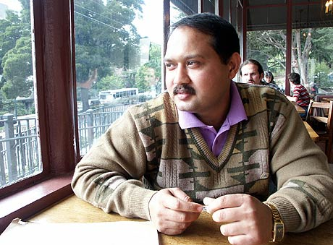
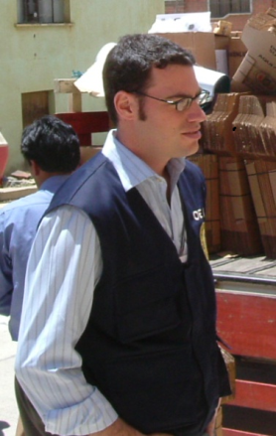
Rotary Peace Fellow Alumni
Nosisa Ncube (Chula, July 2007)
Nani Mahanta (Berkeley, 2002-04)
Bautista Logioco (Duke/UNC 2002-04)
Notes:
Here are just three examples of Rotary Peace Fellow alumni making a difference in the world:
Nosisa Ncube (Chulalongkorn University, July 2007) protects orphaned children from abuse in the rural communities around Bulawayo in Zimbabwe with the Child and Guardian Foundation. She is also part of the Mediators Beyond Borders team for Zimbabwe and has been trained as a facilitator as part of the Alternatives to Violence Program in Zimbabwe.
Nani Mahanta (Berkeley, 2002-04) spearheaded an initiative to open a two-year post graduate peace and conflict studies program at Gauhati University in Assam, India where he is an associate professor of political science.
Bautista Logioco (Duke/UNC 2002-04) received The Young Outstanding Persons award in his native Argentina in the contributions to world peace and human rights category. The award recognized his work as a program specialist with the United Nations Interagency Framework Team for Preventive Action, United Nations Department of Peace Keeping Operations, and the Organization of American States Mission to Support the Peace Process in Colombia.

Slide 14
2014-16 Rotary Peace Fellow Statistics
 | All Applicants | Selected Fellows (Just Masters) | Selected Fellows (Just Certificate)
Gender | 58.2% Female 40.9% Male | 62% Female 38% Male | 54% Female 46% Male
Citizenship from Low-Income Country | 57% | 38% | 56%
Average Age | 32 Years | 27 years | 36 Years
Average # of years of work experience | 8 Years | 8 Years | 8 Years
Previous Work Experience | NGO or MLI: 36% Government: 11% Education: 20% Law 6% | NGO or MLI: 26% Government: 6% Education: 7% Law: 2% | NGO or MLI: 22% Education: 4% Government: 8% Law: 6%
Average IELTS | 6.5 | 7 | n/a
Average TOEFL | 117 | 120 | n/a
Notes:
This shows the demographic for fellows selected for the 2014 class. In addition successful candidates have strong record of academic success, a vested interest in returning to the field after their fellowships are concluded, and the strong support of local Rotarians and recommendations.

Slide 15
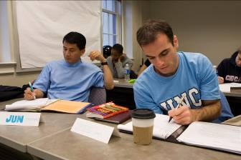
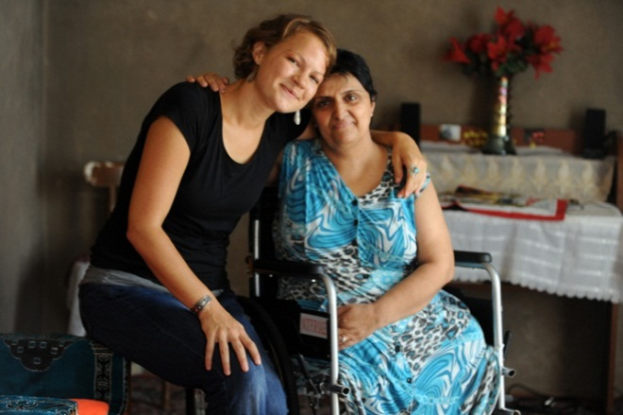
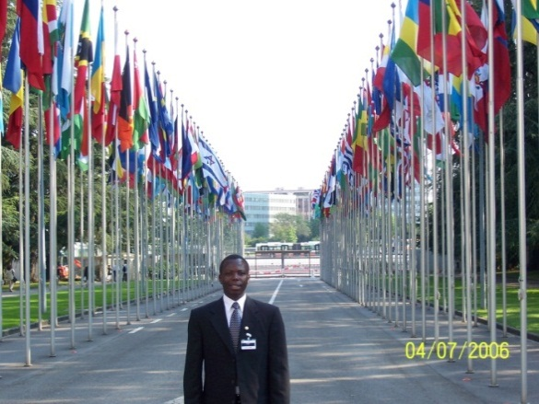
Take Action
Recruit qualified Rotary Peace Fellowship applicants
Advertise the Rotary Peace Fellowship
Support the program by encouraging your district to become a Peacebuilder District
Join the Rotarian Action Group for Peace
Notes:
Here are four ways you can help Rotary build peace.

Slide 16
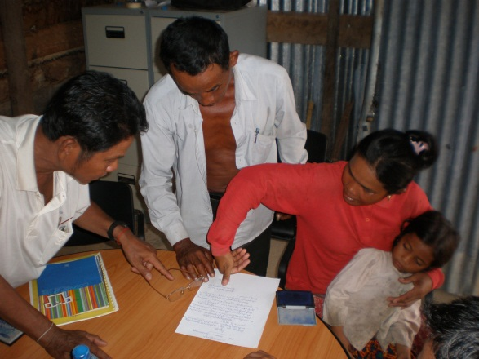
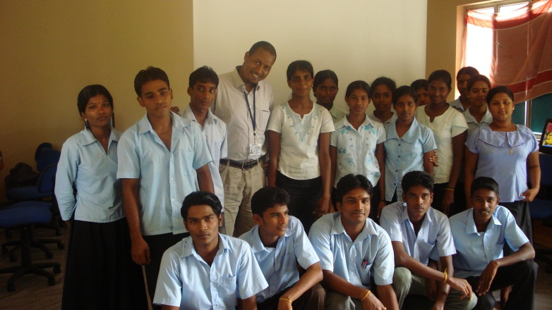
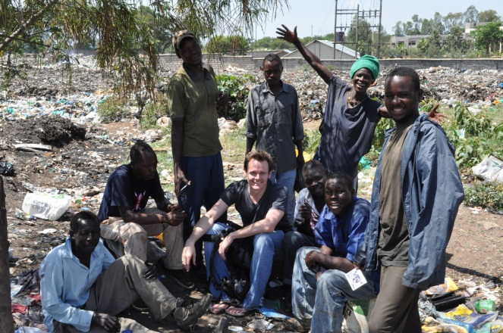
Recruit Applicants
Send out a press release
Meet with community partners
Promote the fellowship on social media
Notes:
Recruiting qualified applicants does not have to be difficult. Consider sending out a press release to your local media, meet with community partners, and promote the fellowship on social media. Start a conversation about the Rotary Peace Fellowship. The wider you cast your net the more likely you are to catch good applicants!
Think about reaching out to university alumni associations and career offices, returned Peace Corps Volunteers, former Ambassadorial Scholars, Non-governmental organizations involved in peace and conflict resolution, international organizations and corporations in your community, governmental agencies, diplomatic corps, local police and military offices.

Slide 17
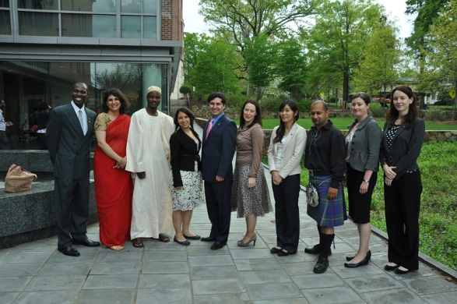
Application Timeline
January - June Districts interview, select and endorse applicants and send to The Rotary Foundation for processing
January- April Clubs and Districts recruit applicants
All Applications Due by 1 July!
October Fellows selected in a world-competitive selection process by the selection committee
June- September TRF processes applications. Districts will receive confirmation email when completed application is received.
Notes:
All applications must come to Rotary through the district level.
In the beginning of the year, clubs and districts recruit potential applicants. Late in the spring districts interview, select, and endorse applicants. DGs and DRFCs or Peace Chairs must endorse the application and send the completed application to The Rotary Foundation preferably via email. All applications are due by 1 July. District DG, DRFC and club presidents will receive a confirmation when a completed application is received. Please note that incomplete applications will not be processed until all material is received. Districts may submit any number of qualified, endorsed applicants and thanks to SHARE the funding for the fellows does not impact your DDF. The Rotary Peace Centers Committee selects up to 50 Master’s Fellows and up to 50 certificate Fellows in October. All applicants and their supporting Rotarians will be notified of applicant’s status in early November.

Slide 18
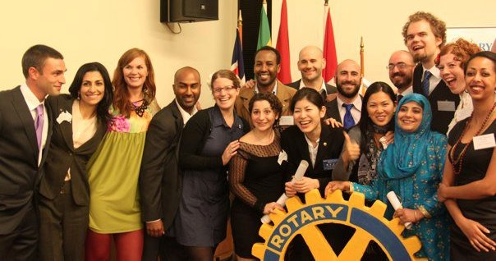
Rotary Peace Centers Major Gifts Initiative
US$88 million raised toward the goal of US$125 million by 30 June 2015 to support the program.
The Major Gifts Initiative goal includes:
Original goal included endowed gifts goal of US$90 million
Term Gifts goal of US$5 million has been surpassed
Districts worldwide contribute DDF as well to a pool of funds supporting the fellowships
Notes:
The Rotary Centers Major Gift Initiative shares the stage with PolioPlus as one of TRF’s highest priorities. Unlike PolioPlus, which is a broad-based initiative, the Rotary Peace Centers Initiative emphasizes gifts of $50,000 or more. The trustees recently increased the goal from US$95 million to US$125 million, in order to more fully meet the real expenses of the program. The majority of these funds are committed to underwriting the expenses of the Rotary Peace Fellows, including tuition, transportation, housing, and other related educational expenses.
The focus of the Rotary Peace Centers Major Gifts Initiative is endowed gifts, but it is expected that about 10 percent of the gifts that come in will be term (immediately expended) gifts to help with the ongoing expenses of running the program.
About 3,000 individuals from throughout the world have contributed gifts and commitments to The Rotary Centers. DDF transfers to endowment also support the initiative.

Slide 19
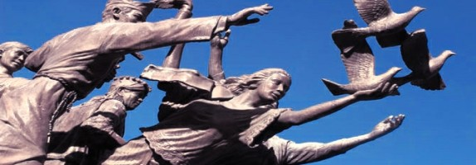
Rotarian Action Group for Peace
Mission: Serve as a resource to Rotarians, Rotary clubs and districts by supporting the peace work of Rotarians worldwide.
Website: rotarianactiongroupforpeace.org
Imagine a World
Beyond War
Built by
Rotarians.
Notes:
The Rotarian Action Group for Peace, which formed in 2012, is an action-driven group of Rotarians, Rotarians’ spouses and Rotaractors working together for the purpose of advancing peace and preventing wars throughout the world.
Their website has information about projects, events, and news about Rotarian’s work toward peace.

Slide 20
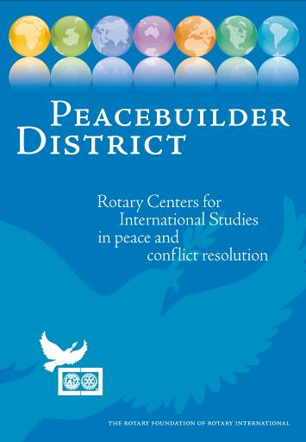
Peacebuilder Districts
Allocate a minimum of US$50,000 over two years from their District Designated Funds
Continue to donate US$25,000 a year in DDF to maintain Peacebuilder Status
Receive specialized Peacebuilder District banner, peace pins and certificate as well as the opportunity to “adopt” a peace fellow
To become a Peacebuilder District contact the Rotary Peace Center Program Coordinator at kathleen.obrien@rotary.org.
Notes:
Peacebuilder Districts allocate a minimum of US$50,000 over two years from their District Designated Funds to support Rotary Peace Fellows. Districts committed to building peace continue to donate US$25,000 a year in DDF to maintain their Peacebuilder Status. For their generous commitment, Peacebuilder districts are recognized by The Rotary Foundation with a specialized Peacebuilder District banner, peace pins and certificate. Peacebuilder District Banner shown above
Peacebuilder Districts also have the opportunity to “adopt” a peace fellow and follow the experience of being a Rotary Peace Fellow. From annual reports to summaries of fellows’ Applied Field Experiences around the world to career and project updates, your district will hear how peace is being created in the world. Reading and listening to fellows’ stories will illuminate what Rotary is doing in practical ways to make this a more peaceful world.
Take the Next Step to Create Peace
To become a Peacebuilder District or learn more about donating DDF to the Rotary Peace Centers Program, please contact Kat O’Brien, Program Coordinator, Rotary Peace Centers Department, The Rotary Foundation, 1560 Sherman Ave, Evanston, IL 60201; fax: +847 556 2141; e-mail: kathleen.obrien@rotary.org

Slide 21
Get more information about the program
Subscribe to the Peace Net Newsletter by registering with MyRotary.org, select Member News, select Newsletters, and then check the box for Peace Net
Visit www.rotary.org/en/peace-fellowships
Rotary Peace Centers videos on Vimeo and the Rotary web site
“Like” the Rotary Peace Centers on www.facebook.com/rotarycenters
Notes:
The Rotary Peace Centers program wants to keep you informed about what’s happening with the program. Please subscribe to Peace Net, check out www.rotary.org/en/peace-fellowships, view the video on Vimeo, and “Like” the Rotary Peace Centers on Facebook.

Slide 22
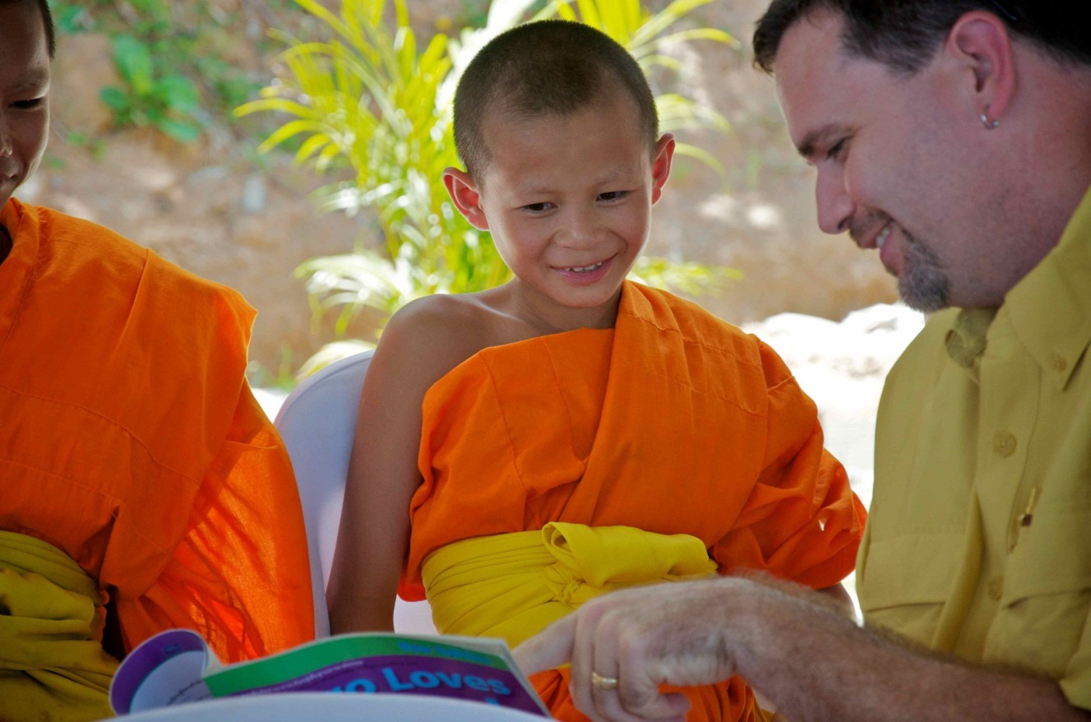
Questions?
For information about recruitment or promotional questions, please contact Kat O’Brien, kathleen.obrien@rotary.org
For general information, please contact rotarypeacecenters@rotary.org

